Slide 1
CASSANDRA
-NOSQL JOURNEY

Slide 2

We are not going to learn about her ☺

Slide 3

But About Her ☺

Slide 4
Introduction to Cassandra
Apache Cassandra is an open source distributed database management system designed to handle large amounts of data across many commodity servers, providing high availability with no single point of failure.
Cassandra offers robust support for clusters spanning multiple datacenters, with asynchronous masterless replication allowing low latency operations for all clients

Slide 5
A distributed database
In computing, distributed means splitting data or tasks across multiple machines.
In the context of Cassandra, it means that the data is distributed across multiple machines. It means that no single node (a machine in a cluster is usually called a node) holds all the data, but just a chunk of it. It means that you are not limited by the storage and processing capabilities of a single machine.
If the data gets larger, add more machines. If you need more parallelism (ability to access data in parallel/concurrently), add more machines. This means that a node going down does not mean that all the data is lost (we will cover this issue soon).

Slide 6


Slide 7
How is it possible?
One of the Answers to it is Replication

Slide 8
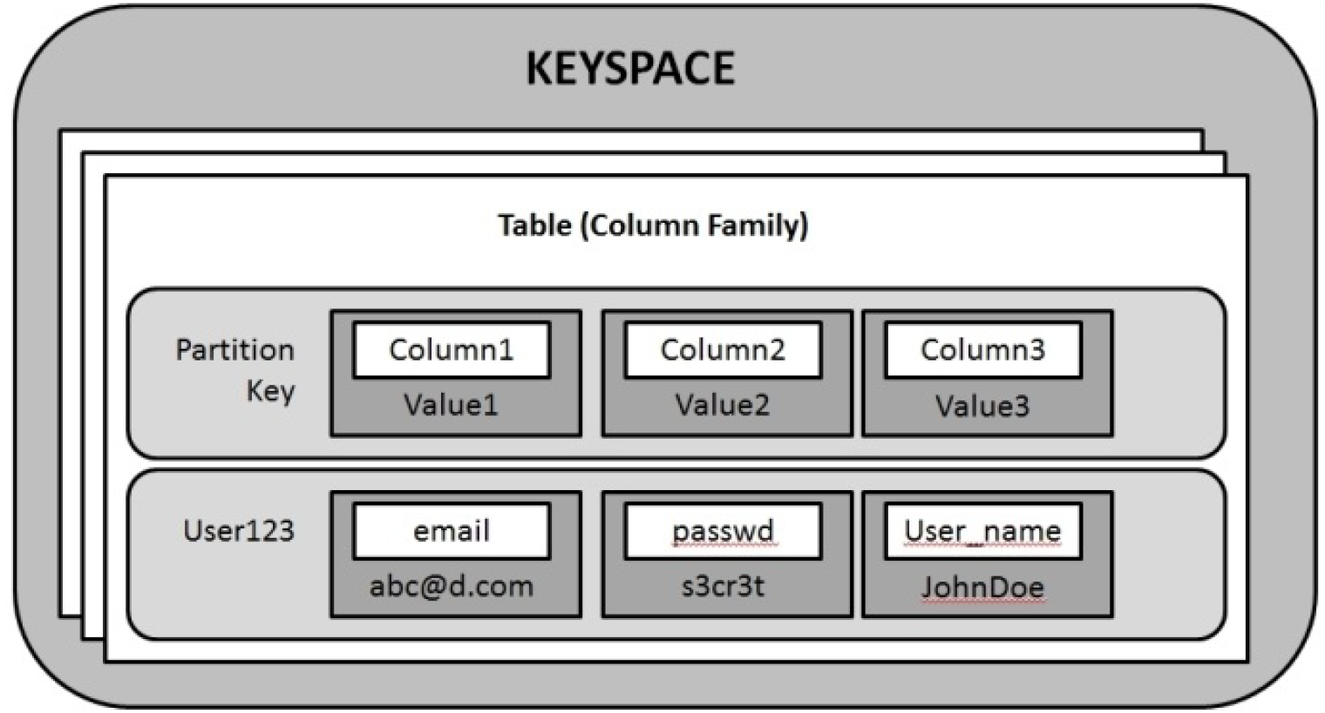
CASSANDRA DATA MODEL:

Slide 9
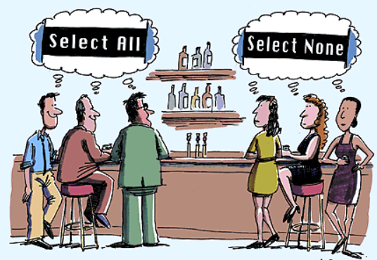
Its not just about ☺

Slide 10
Benefits of Flexible Columnar Storage:
One obvious benefit of having such a flexible data storage mechanism is that you can have arbitrary number of cells with customized names and have a partition key store data as a list of tuples (a tuple is an ordered set; in this case, the tuple is a key-value pair).
This comes handy when you have to store things such as time series, for example, if you want to use Cassandra to store your Facebook timeline or your Twitter feed or you want the partition key to be a sensor ID and each cell to represent a tuple with name as the timestamp when the data was created and value as the data sent by the sensor.
Also, in a partition, cells are by default naturally ordered by the cell’s name. So, in our sensor case, you will get data sorted for free

Slide 11
Its all about Denormalization:
Denormalization is a process of adding redundancy in data to achieve high read performance
Unlike RDBMS, there is no relation, no joins, no complex queries
But it can be handled at an application Level

Slide 12
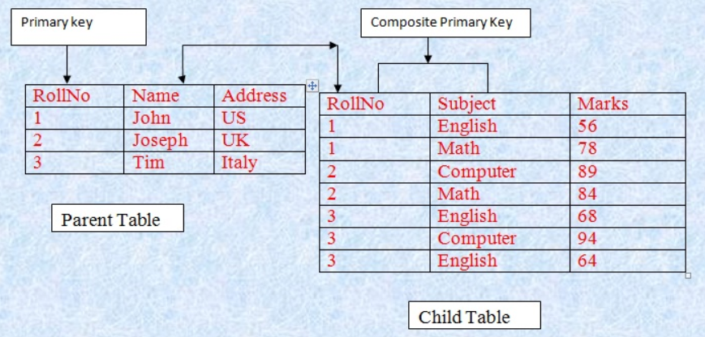
Relational World

Slide 13
Keys in Cassandra
Primary key: This is the column or a group of columns that uniquely defines a rowof the CQL table.
Composite key: This is a type of primary key that is made up of more than one column. Sometimes, the composite key is also referred to as the compound key.
Partition key: Cassandra’s internal data representation is large rows with a unique key called row key. It uses these row key values to distribute data across cluster nodes. Since these row keys are used to partition data, they as called partition keys. When you define a table with a simple key, that key is the partition key. If you define a table with a composite key, the first term of that composite key works as the partition key. This means all the CQL rows with the same partition key lives on one machine.
Clustering key: This is the column that tells Cassandra how the data within a partition is ordered (or clustered). This essentially provides presorted retrieval if you know what order you want your data to be retrieve in.
Composite partition key: Optionally, CQL lets you define a composite partition key (the first part of a composite key). This key helps you distribute data across nodes if any part of the composite partition key differs

Slide 14
EXAMPLE 1:
CREATE TABLE customers (id uuid,email text,
PRIMARY KEY (id))
In the preceding example, id is the primary key and also the partition key. There is no clustering. It is a simple key

Slide 15
EXAMPLE 2:
CREATE TABLE country_states (country text,state text,
population int,PRIMARY KEY (country, state))
In the preceding example, we have a composite key that uses country and state to uniquely define a CQL row. The country column is the partition key, so all the rows with the same country node will belong to the same node/machine. The rows within a partition will be sorted by the state names. So, when you query for states in the US, you will encounter the row with California before the one with New York

Slide 16
EXAMPLE 3:
CREATE TABLE country_chiefs (country text,prez_name text,num_states int,capital text,ruling_year int,PRIMARY KEY ((country, prez_name), num_states, capital))
The preceding example has a composite key involving four columns: country, prez_name, num_states, and capital, with country and prez_name constituting composite partition key.
This means the rows with the same country but different president will be in a different partition. Rows will be ordered by the number of states followed by the capital name

Slide 17
Installing Cassandra

Slide 18
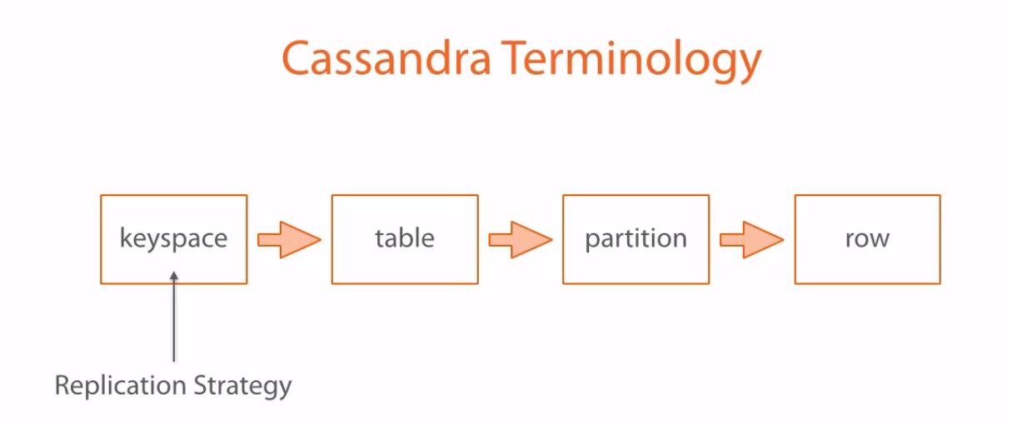

Slide 19

CASSANDRA IN ACTION

Slide 20
BACKEND OF SIMPLE BLOGGING APP
Create a blogging account
Publish posts
Tag the posts, and posts can be searched using those tags
Have people comment on those posts
Have people upvote or downvote a post or a comment

Slide 21
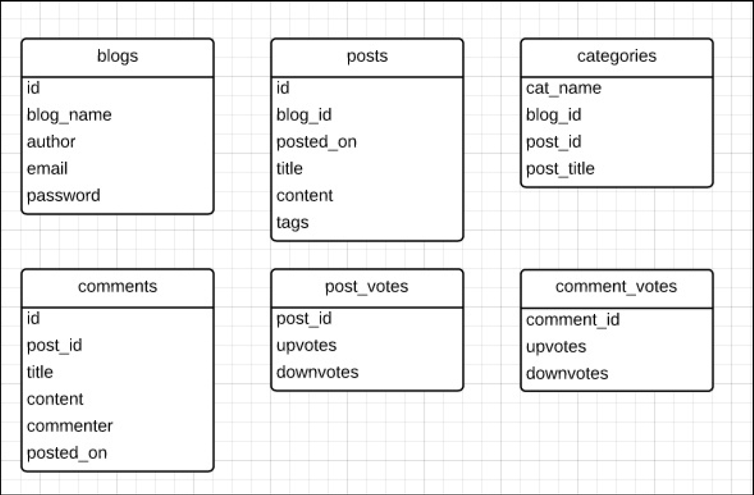
DATA MODELLING

Slide 22
INITIAL THINKING:
We need a blogs table to store the blog name and other global information, such as the blogger’s username and password
We will have to pull posts for the blog, ideally, sorted in reverse chronological order
We will also have to pull all the comments for each post, when we see the post page
We will have to maintain tags in such a way that tags can be used to pull all the posts with the same tag
We will also have to have counters for the upvotes and downvotes for posts and comments

Slide 23
cqlsh> CREATE KEYSPACE weblog WITH REPLICATION = {'class': 'SimpleStrategy', 'replication_factor': 1};
cqlsh> USE weblog;
cqlsh:weblog> CREATE TABLE blogs (id uuid PRIMARY KEY, blog_name varchar,author varchar, email varchar, password varchar);
cqlsh:weblog> CREATE TABLE posts (id timeuuid, blog_id uuid, posted_on timestamp, title text, content text, tags set<varchar>, PRIMARY KEY(blog_id, id));
cqlsh:weblog> CREATE TABLE categories (cat_name varchar, blog_id uuid, post_id timeuuid, post_title text, PRIMARY KEY(cat_name, blog_id, post_id));

Slide 24
cqlsh:weblog> CREATE TABLE comments (id timeuuid, post_id timeuuid, title text, content text, posted_on timestamp, commenter varchar, PRIMARY KEY(post_id, id));
cqlsh:weblog> CREATE TABLE post_votes(post_id timeuuid PRIMARY KEY, upvotes counter, downvotes counter);
cqlsh:weblog> CREATE TABLE comment_votes(comment_id timeuuid PRIMARY KEY, upvotes counter, downvotes counter);

Slide 25
cqlsh:weblog> INSERT INTO blogs (id, blog_name, author, email, password) VALUES ( blobAsUuid(timeuuidAsBlob(now())), 'Random Ramblings', 'JRR Rowling', 'rowling@yahoo.com', 'someHashed#passwrd');
cqlsh:weblog> SELECT * FROM blogs;

Slide 26
# FIRST POST
cqlsh:weblog> INSERT INTO posts (id, blog_id, title, content, tags, posted_on) VALUES (now(), 83cec740-22b1-11e4-a4f0-7f1a8b30f852, 'first post', 'hey howdy!', {'random','welcome'}, 1407822921000);
cqlsh:weblog> SELECT * FROM posts;

Slide 27
cqlsh:weblog> INSERT INTO categories (cat_name, blog_id, post_id, post_title) VALUES ( 'random', 83cec740-22b1-11e4-a4f0-7f1a8b30f852, 047224f0-22b2-11e4-a4f0-7f1a8b30f852, 'first post');
cqlsh:weblog> INSERT INTO categories (cat_name, blog_id, post_id, post_title) VALUES ( 'welcome', 83cec740-22b1-11e4-a4f0-7f1a8b30f852, 047224f0-22b2-11e4-a4f0-7f1a8b30f852, 'first post');

Slide 28
# SECOND POST
cqlsh:weblog> INSERT INTO posts (id, blog_id, title, content, tags, posted_on) VALUES (now(), 83cec740-22b1-11e4-a4f0-7f1a8b30f852, 'Fooled by randomness…', 'posterior=(prior*likelihood)/evidence', {'random','maths'}, 1407823189000);
cqlsh:weblog> select * from posts;

Slide 29
cqlsh:weblog> INSERT INTO categories (cat_name, blog_id, post_id, post_title) VALUES ( 'random', 83cec740-22b1-11e4-a4f0-7f1a8b30f852, c06a42f0-22b2-11e4-a4f0-7f1a8b30f852, 'Fooled by randomness…');
cqlsh:weblog> INSERT INTO categories (cat_name, blog_id, post_id, post_title) VALUES ( 'maths', 83cec740-22b1-11e4-a4f0-7f1a8b30f852, c06a42f0-22b2-11e4-a4f0-7f1a8b30f852, 'Fooled by randomness…');

Slide 30
# INSERT SOME COMMENTS
cqlsh:weblog> INSERT INTO comments (id, post_id, commenter, title, content, posted_on) VALUES (now(), c06a42f0-22b2-11e4-a4f0-7f1a8b30f852, 'liz@gmail.com', 'Thoughful article but…', 'It is too short to describe the complexity.', 1407868973000);
cqlsh:weblog> INSERT INTO comments (id, post_id, commenter, title, content, posted_on) VALUES (now(), c06a42f0-22b2-11e4-a4f0-7f1a8b30f852, 'tom@gmail.com', 'Nice!', 'Thanks, this is good stuff.', 1407868975000);
cqlsh:weblog> INSERT INTO comments (id, post_id, commenter, title, content, posted_on) VALUES (now(), c06a42f0-22b2-11e4-a4f0-7f1a8b30f852, 'g@ouv.com', 'Follow my blog', 'Please follow my blog.', 1407868979000);
cqlsh:weblog> INSERT INTO comments (id, post_id, commenter, title, content, posted_on) VALUES (now(), 047224f0-22b2-11e4-a4f0-7f1a8b30f852, 'liz@gmail.com', 'New blogger?', 'Welcome to weblog application.', 1407868981000);

Slide 31
# INSERT SOME VOTES
cqlsh:weblog> UPDATE comment_votes SET upvotes = upvotes + 1 WHERE comment_id = be127d00-22c2-11e4-a4f0-7f1a8b30f852;
cqlsh:weblog> UPDATE comment_votes SET upvotes = upvotes + 1 WHERE comment_id = be127d00-22c2-11e4-a4f0-7f1a8b30f852;
cqlsh:weblog> UPDATE comment_votes SET downvotes = downvotes + 1 WHERE comment_id = be127d00-22c2-11e4-a4f0-7f1a8b30f852;
cqlsh:weblog> UPDATE post_votes SET downvotes = downvotes + 1 WHERE post_id = d44e0440-22c2-11e4-a4f0-7f1a8b30f852;
cqlsh:weblog> UPDATE post_votes SET upvotes = upvotes + 1 WHERE post_id = d44e0440-22c2-11e4-a4f0-7f1a8b30f852;

Slide 32
RETRIEVING DATA
cqlsh:weblog> select * from posts where blog_id = 83cec740-22b1-11e4-a4f0-7f1a8b30f852 order by id desc limit 2;
cqlsh:weblog> select * from posts where blog_id = 83cec740-22b1-11e4-a4f0-7f1a8b30f852 and id < 8eab0c10-2314-11e4-bac7-3f5f68a133d8 order by id desc limit 2;
cqlsh:weblog> select * from posts where blog_id = 83cec740-22b1-11e4-a4f0-7f1a8b30f852 and id < 76738dc0-2314-11e4-bac7-3f5f68a133d8 order by id desc limit 2;

Slide 33
To make a nonprimary key field searchable in Cassandra,you need to create an index on that column
cqlsh:weblog> CREATE INDEX commenter_idx ON comments (commenter);
cqlsh:weblog> select * from comments where commenter = 'liz@gmail.com';

Slide 34
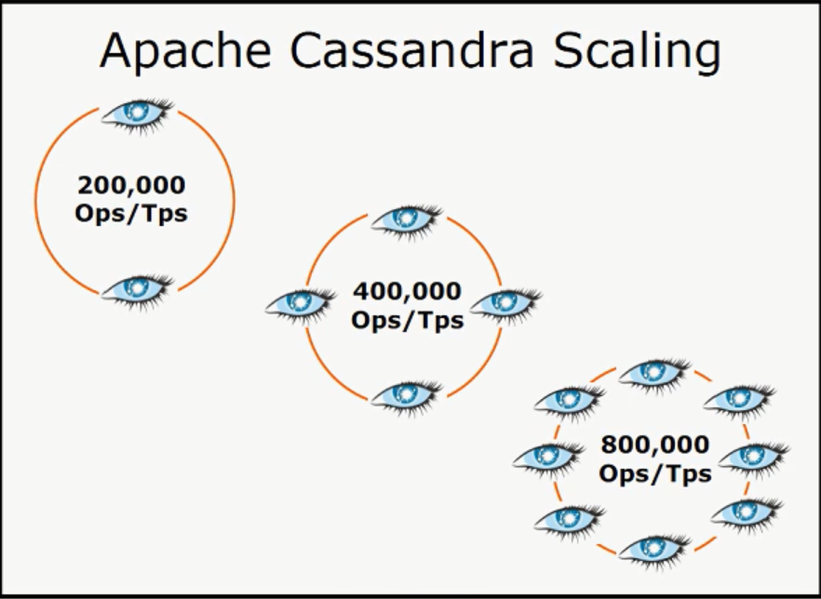

Slide 35
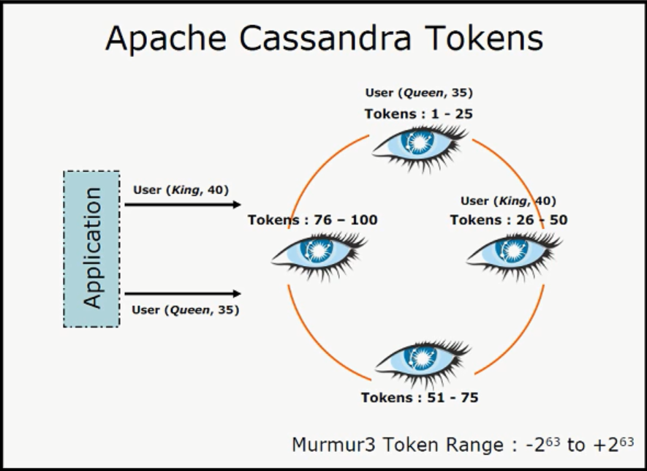
Ring Tokenization:

Slide 36
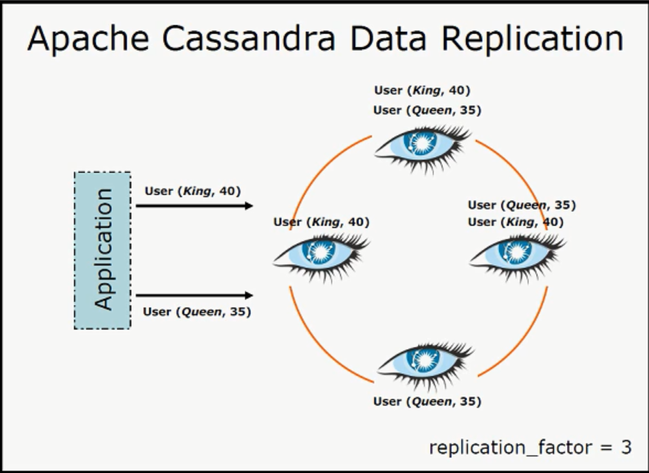

Slide 37
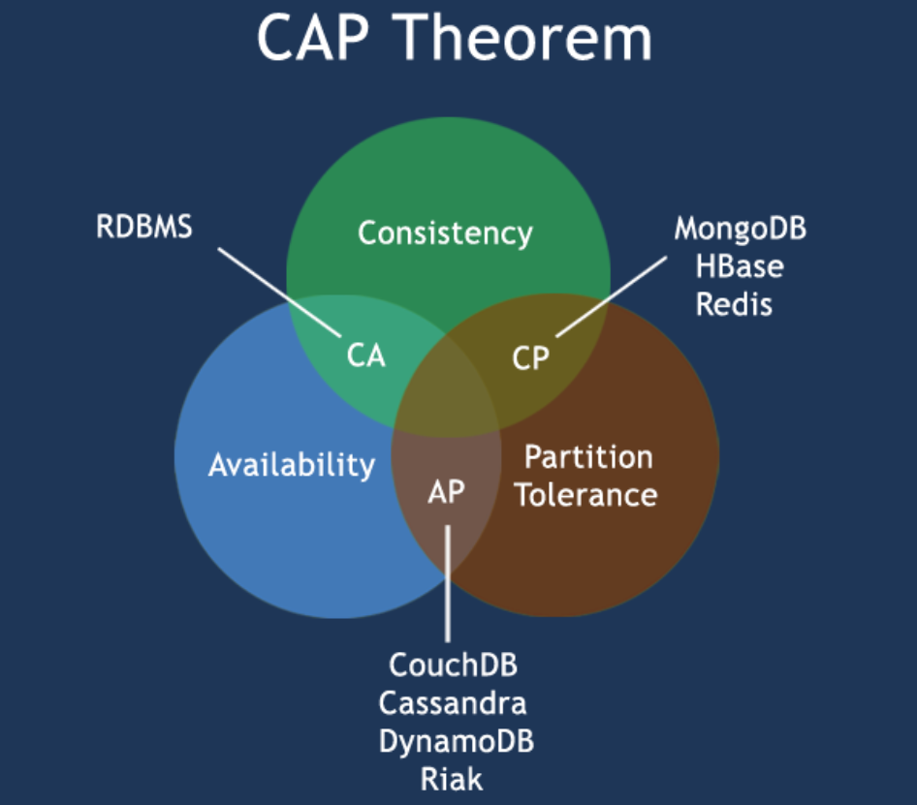
CAP THEOREM:

Slide 38
Consistency
Every read receives the most recent write or an error

Slide 39
Availability
Every request receives a (non-error) response – without guarantee that it contains the most recent write

Slide 40
Partition Tolerance
The system continues to operate despite an arbitrary number of messages being dropped (or delayed) by the network between nodes

Slide 41
Tunable or Eventual Consistency
Eventual consistency is a consistency model used in distributed computing to achieve high availability that informally guarantees that, if no new updates are made to a given data item, eventually all accesses to that item will return the last updated value.

Slide 42
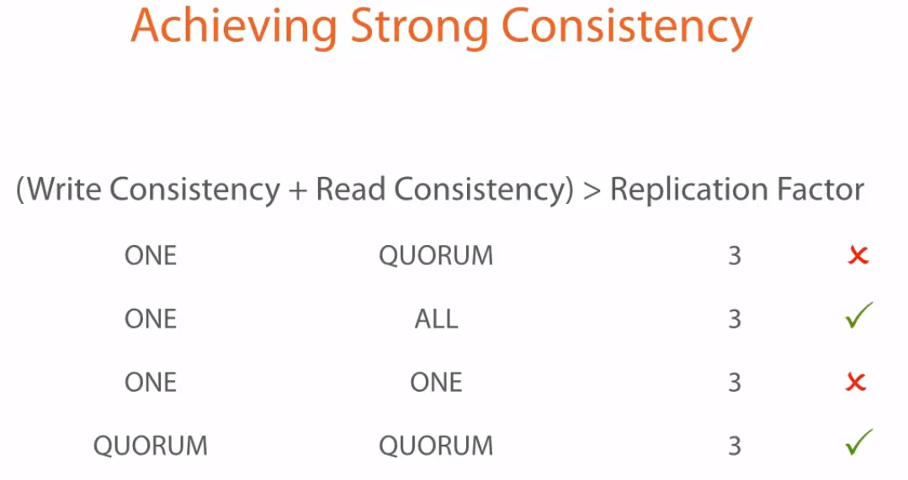

Slide 43
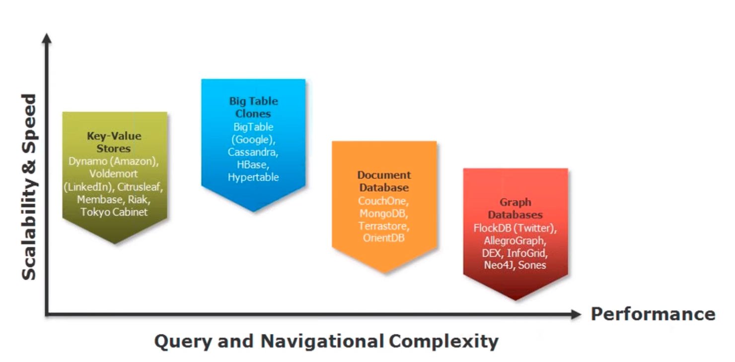
NOSQL LANDSCAPE

Slide 44
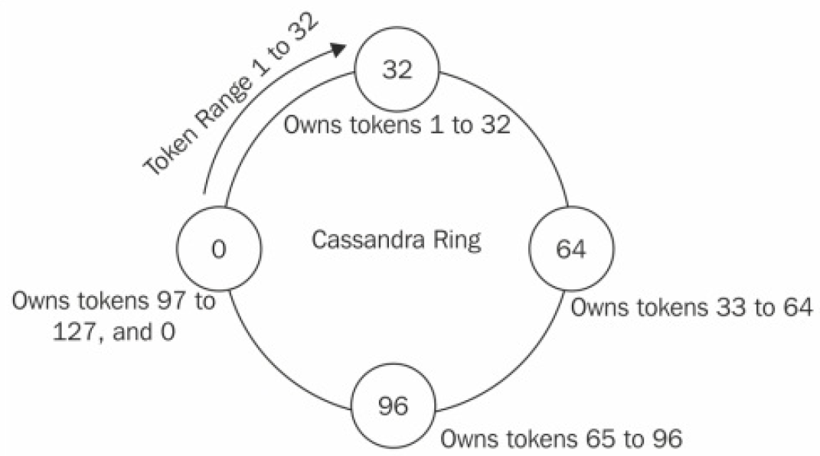
Ring Representation

Slide 45
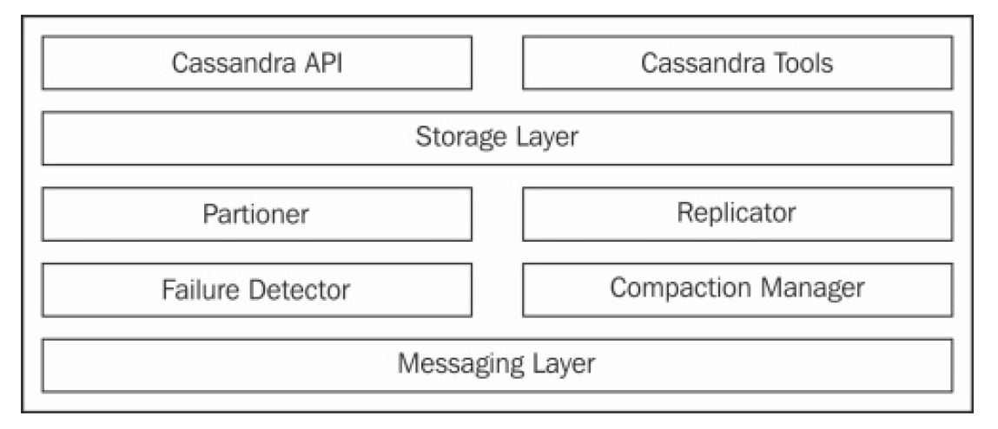
HOW CASSANDRA WORKS?

Slide 46
Basic Info on Architecture::
The main class of Storage Layer is StorageProxy. It handles all the requests. The messaging layer is responsible for inter-node communications, such as gossip. Apart from this, process-level structures keep a rough idea about the actual data containers and where they live.
There are four data buckets that you need to know. MemTable is a hash table-like structure that stays in memory. It contains actual cell data. SSTable is the disk version of MemTables. When MemTables are full, they are persisted to hard disk as SSTable.
Commit log is an append only log of all the mutations that are sent to the Cassandra cluster

Slide 47
Write in Action
Client can connect to any node (coordinator node) to write anything to Cassandra
And based on the replication strategy being decided, it waits only till minimum replication criterion is satisfied
That is called tunable consistency level

Slide 48
Read in Action
Almost similar to write, but here the Storage proxy will search the data within nearest proximity
This nearest proximity function is called as Snitch function

Slide 49

Its more interesting than this one ☺

Slide 50
Types of Snitches:
SimpleSnitch: A closer node is the one that comes first when moving clockwise in the ring
PropertyFileSnitch: This snitch allows you to specify how you want your machines’ location to be interpreted by Cassandra. You do this by assigning a data center name and rack name for all the machines in the cluster in the $CASSANDRA_HOME/conf/cassandra-topology.properties file. Each node has a copy of this file and you need to alter this file each time you add or remove a node

Slide 51
Property Snitch file Example::
# Cassandra Node IP=Data Center:Rack
192.168.1.100=DC1:RAC1
192.168.2.200=DC2:RAC2
10.0.0.10=DC1:RAC1
10.0.0.11=DC1:RAC1
10.0.0.12=DC1:RAC2
10.20.114.10=DC2:RAC1
10.20.114.11=DC2:RAC1

Slide 52
GossipingPropertyFileSnitch: Similar to PropertyFileSnitch, you have a file called $CASSANDRA_HOME/conf/cassandra-rackdc.properties, and in this file you specify the data center and the rack name for that machine.The gossip protocol makes sure that this information gets spread to all the nodes in the cluster

Slide 53
RackInferringSnitch: This snitch infers the location of a node based on its IP address. It uses the third octet to infer rack name, and the second octet to assign data center.
If you have four nodes 10.110.6.30, 10.110.6.4, 10.110.7.42, and 10.111.3.1, this snitch will think the first two live on the same rack as they have the same second octet (110) and the same third octet (6), while the third lives in the same data center but on a different rack as it has the same second octet but the third octet differs. Fourth, however, is assumed to live in a separate data center as it has a different second octet than the three

Slide 54
DynamicSnitch: This Snitch determines closeness based on a recent performance delivered by a node. So, a quick responding node is perceived as being closer than a slower one, irrespective of its location closeness, or closeness in the ring.
This is done to avoid overloading a slow performing node. DynamicSnitch is used by all the other snitches by default. You can disable it, but it is not advisable

Slide 55
AmazonEC2 SNITCHES -- IS WITH RESPECT TO AMAZON EC2 INSTANCES

Slide 56
What goes on in a Node:
Take a simple case of a read request looking for a single column within a single row. First, the attempt is made to read from MemTable, which is rapid fast, and since there exists only one copy of data, this is the fastest retrieval.
If all required data is not found there, Cassandra looks into SSTable. Now, remember from our earlier discussion that we flush MemTables to disk as SSTables and later when the compaction mechanism wakes up, it merges those SSTables. So, our data can be in multiple SSTables

Slide 57
Each SSTable is associated with its bloom filter built on the row keys in the SSTable.
Bloom filters are kept in the memory and used to detect if an SSTable may contain (false positive) the row data

Slide 58
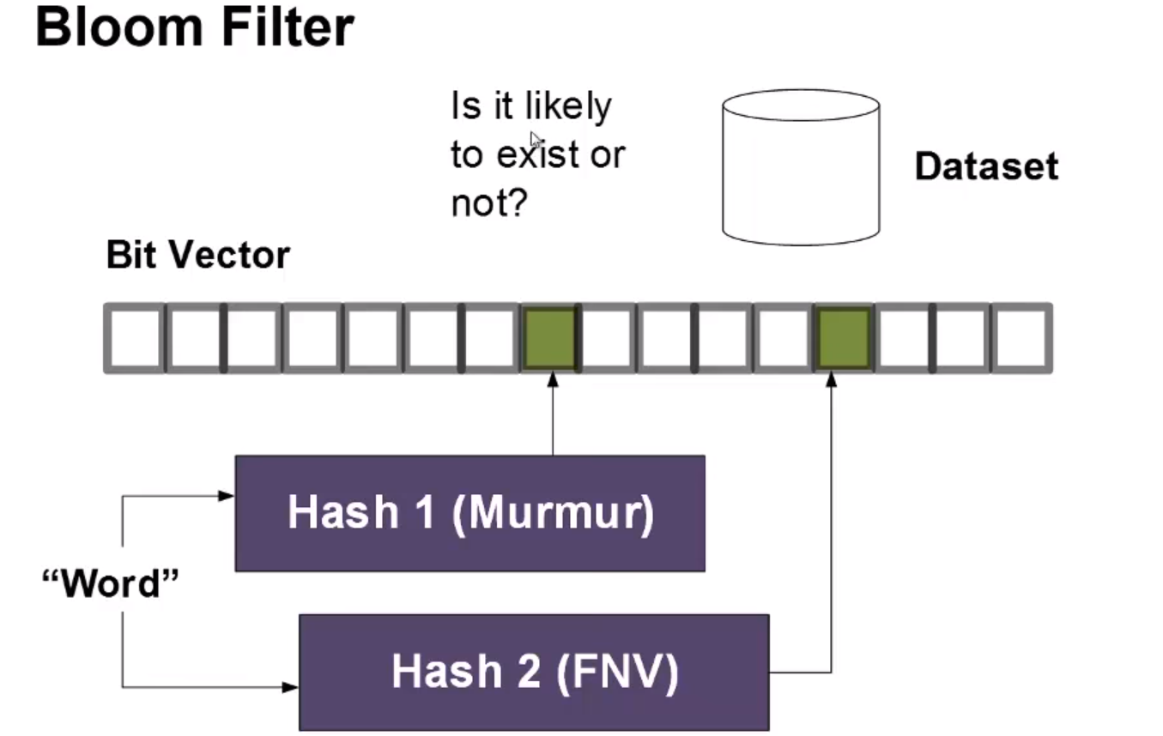
Wait What is Bloom Filter::

Slide 59
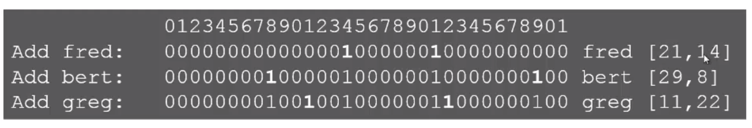

BLOOM CHECK

Slide 60
More knowledge on hashes:
Please visit the below link:
https://asecuritysite.com/encryption

Slide 61
Seed Node
Seed nodes are the nodes that are first contacted by a newly joining node when they first start up. Seed nodes help the newly started node to discover other nodes in the cluster.
It is suggested that to have more than one seed node in a cluster.Seed node is nothing like a master in a master-slave mechanism. It is just another node that helps newly joining nodes to bootstrap gossip protocol. So, seeds are not a single point of failure (SPOF) and neither has any other purpose that makes them superior

Slide 62
PARTITIONER
Partitioner decides the data distribution in the cluster
Below are the list of partitioners available:
Murmur3Partitioner
RandomPartitioner
ByteOrderPartitioner

Slide 63
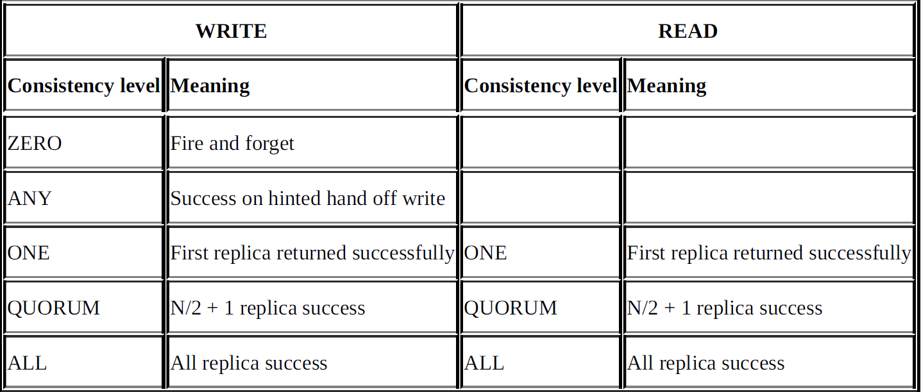
Consistency Decider::

Slide 64
LSM TREE
LSM tree advocates the following mechanism to store data: note down the arriving modification into a log file (commit log), push the modification/new data into memory
(MemTable) for faster lookup, and when the system has gathered enough updates in memory, or after a certain threshold time, flush this data to a disk in a structured store file (SSTable).
The logs corresponding to the updates that are flushed can now be discarded

Slide 65
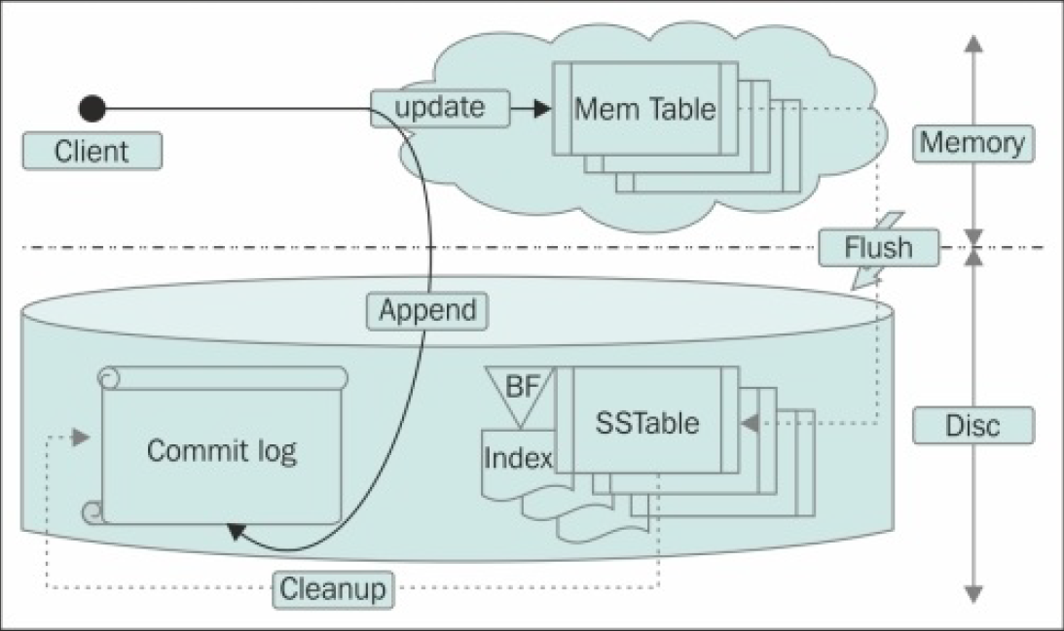
SSTABLE, COMMIT LOG, MEM TABLE

Slide 66
Lifecycle of write:
Commit Log
MemTable
SSTable

Slide 67
Commit Log:
Any write in the node gets tracked by org.apache.cassandra.db.commitlog.CommitLog
It writes the data with certain metadata into the commit log file in such a manner that replaying this will recreate the data
The purpose of this exercise is that there is no data loss

Slide 68

Crash, now what?

Slide 69
Help from Commit Log:
1. Each commit log segment is iterated in the ascending order of timestamp.
2. Lowest ReplayPosition (which is the offset in commit log that specifies the point till which the data is already stored in SSTables) is chosen from the SSTable metadata.
3. The log entry is replayed for a column family if the position of the log entry is greater than the replay position in the latest SSTable metadata.
4. After the log replay is done, all the MemTables are force flushed to a disk, and all the commit log segments are recycled

Slide 70
MemTable:
MemTable is an in-memory representation of a column family. It can be thought of as cached data. MemTable is sorted by key. Data in MemTable is sorted by row key.
Unlike the commit log, which is append-only, MemTable does not contain duplicates.
A new write with a key that already exists in the MemTable, overwrites the older record. This being in memory is both fast and efficient

Slide 71
Write 1: {k1: [{c1, v1}, {c2, v2}, {c3, v3}]}
In CommitLog (new entry, append):
{k1: [{c1, v1},{c2, v2}, {c3, v3}]}
In MemTable (new entry, append):
{k1: [{c1, v1}, {c2, v2}, {c3, v3}]}
Write 2: {k2: [{c4, v4}]}
In CommitLog (new entry, append):
{k1: [{c1, v1}, {c2, v2}, {c3, v3}]}
{k2: [{c4, v4}]}
In MemTable (new entry, append):
{k1: [{c1, v1}, {c2, v2}, {c3, v3}]}
{k2: [{c4, v4}]}
Write 3: {k1: [{c1, v5}, {c6, v6}]}
In CommitLog (old entry, append):
{k1: [{c1, v1}, {c2, v2}, {c3, v3}]}
{k2: [{c4, v4}]}
{k1: [{c1, v5}, {c6, v6}]}
In MemTable (old entry, update):
{k1: [{c1, v5}, {c2, v2}, {c3, v3}, {c6, v6}]}
{k2: [{c4, v4}]}

Slide 72
SSTable:
SSTable is a disk representation of the data. MemTables get flushed to disk to immutable SSTables. MemTables get flushed to individual SSTables, and all the writes are sequential, which makes this process fast. So, the faster the disk speed, the quicker the flush operation.
The SSTables eventually get merged in the compaction process and the data gets organized properly into one file. This extra work in compaction pays off during reads

Slide 73
Data Files
Data files are the actual data. They contain row keys, metadata, and columns (partial or full). Reading data from the data files is just one disk seek, followed by a sequential read, as the offset to a row key is already obtained from the associated index file

Slide 74
Compaction
Compaction merges multiple SSTable files into one. Off the shelf, Cassandra offers two types of compaction mechanisms: size-tiered compaction strategy and level compaction strategy

Slide 75
Read Repair
Let’s say we have three replica nodes, A, B, and C, that contain a data X. During an update, X is updated to X1 in replicas A and B, but it fails in replica C for some reason. On a read request for data X, the coordinator node asks for a full read from the nearest node (based on the configured snitch) and digest of data X from other nodes to satisfy consistency level.
The coordinator node compares these values (something like digest(full_X) == digest_from_node_C). If it turns out that the digests are the same as the digests of the full read, the system is consistent and the value is returned to the client. On the other hand, if there is a mismatch, full data is retrieved and reconciliation is done and the client is sent the reconciled value.
After this,in the background, all the replicas are updated with the reconciled value to have a consistent view of data on each node.

Slide 76
Anti Entropy
Anti-entropy compares all the replicas of a column family and updates the replicas to the latest version. This happens during major compaction. It uses Merkle trees to determine discrepancies among the replicas and fixes them

Slide 77
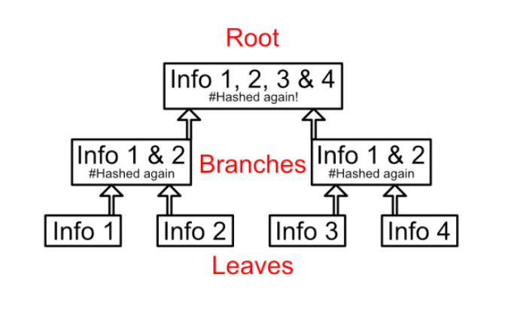
MERKLE TREE

Slide 78
How it works:
Two units of information are individually hashed. These are known as Merkle leaves.
Those two hashes are then hashed together. These are known as Merkle branches.
Multiple branches are hashed together finally getting one single hash. This is known as a Merkle root.

Slide 79
Usage of Merkle Tree
A Merkle tree is useful because it allows computers to verify information at the bottom of the tree, the leaves, without having to store the entire set of information

Slide 80

Applications::

Slide 81
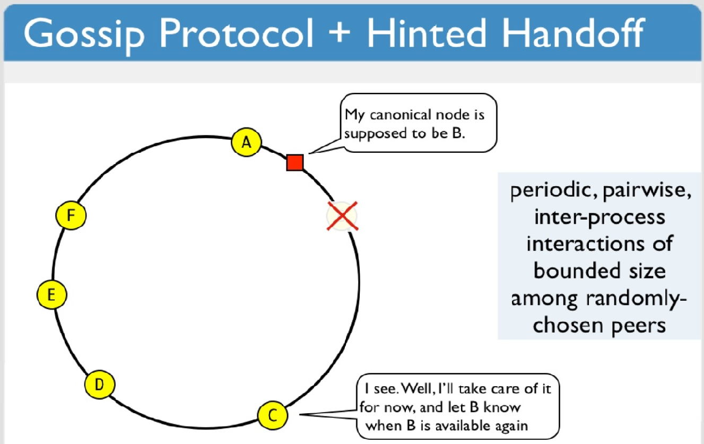
Hinted Handoff:

Slide 82
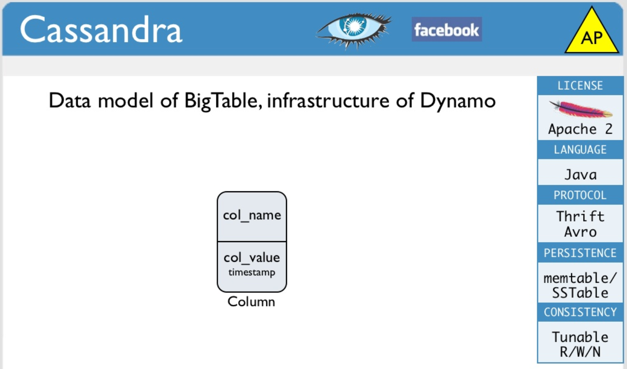
Brief HeadsUp:

Slide 83
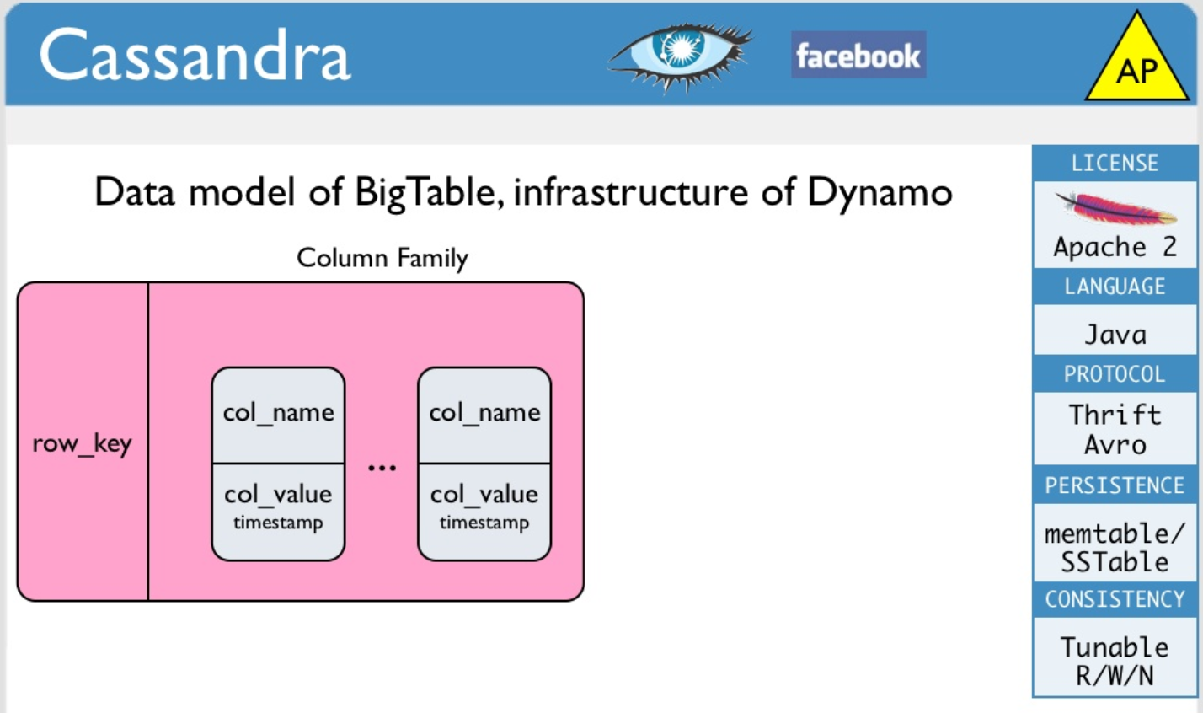
Col. Family:

Slide 84
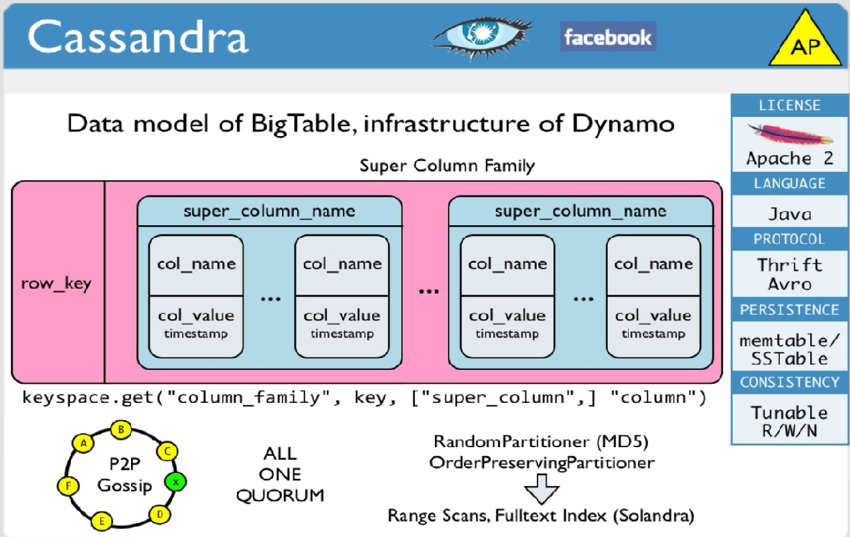
All in One ☺

Slide 85
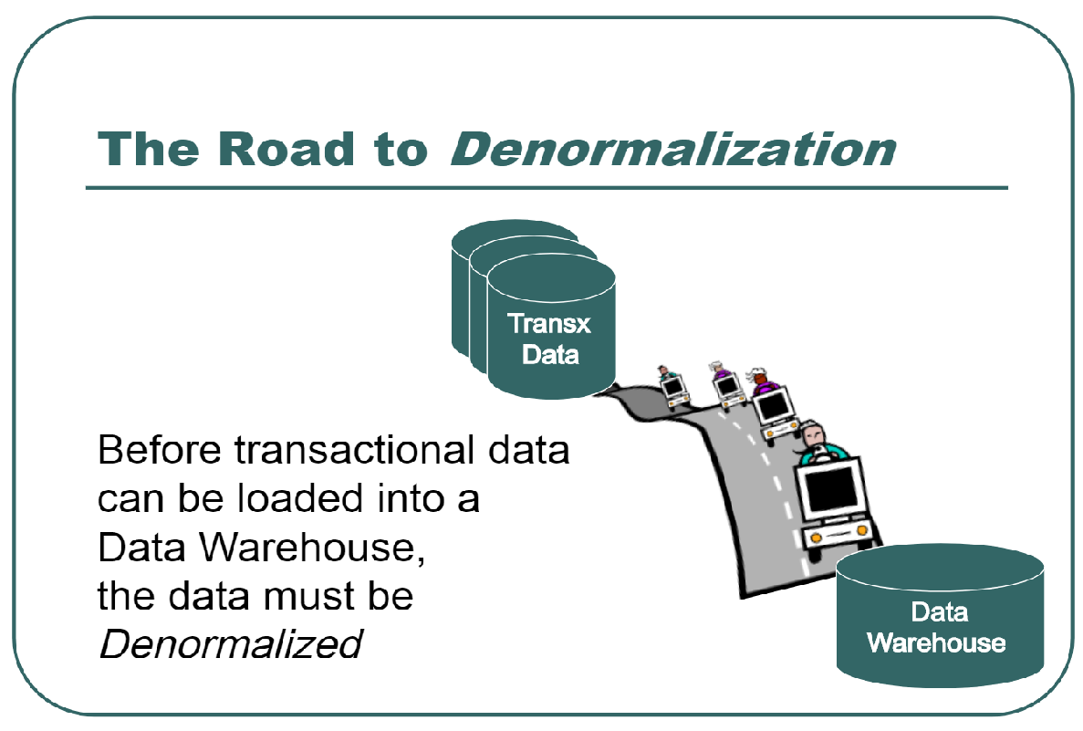
Denormalize, denormalize, denormalize

Slide 86
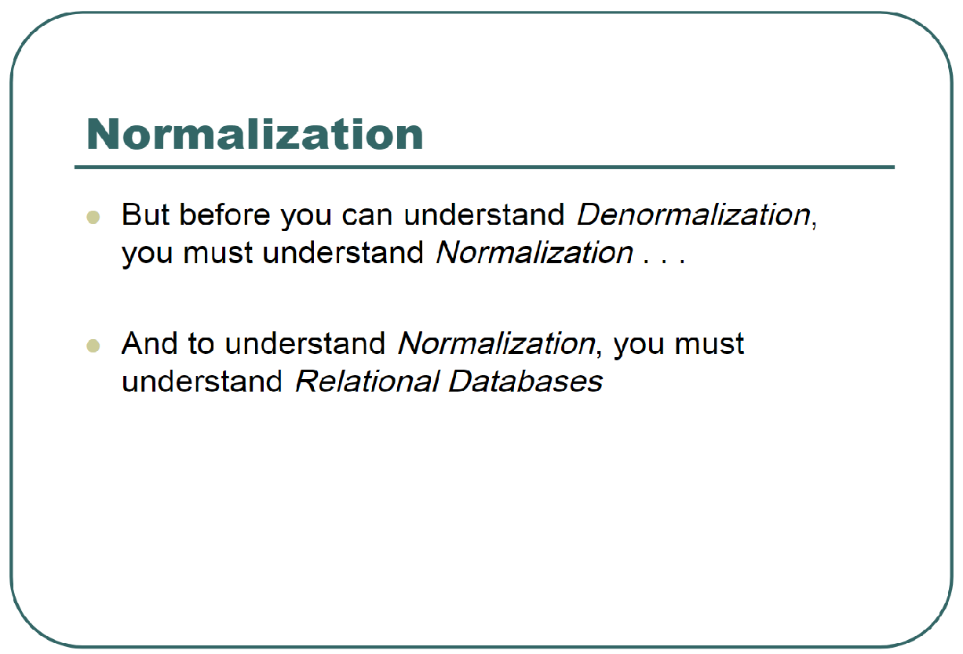
First one needs to know Normalization

Slide 87
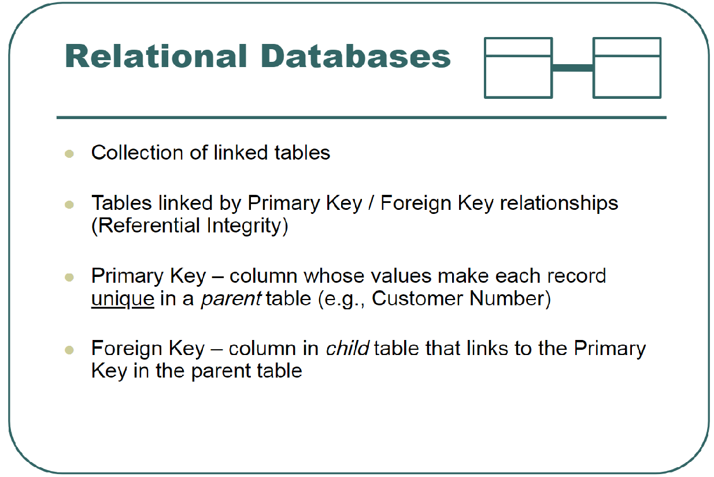
RDBMS

Slide 88
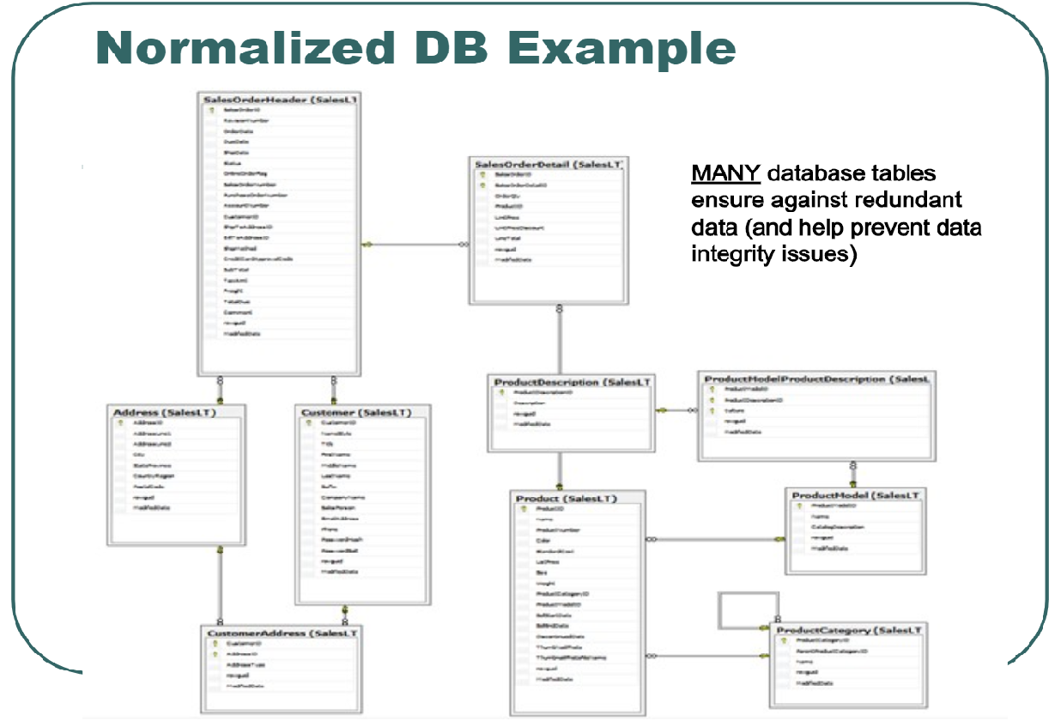

Slide 89
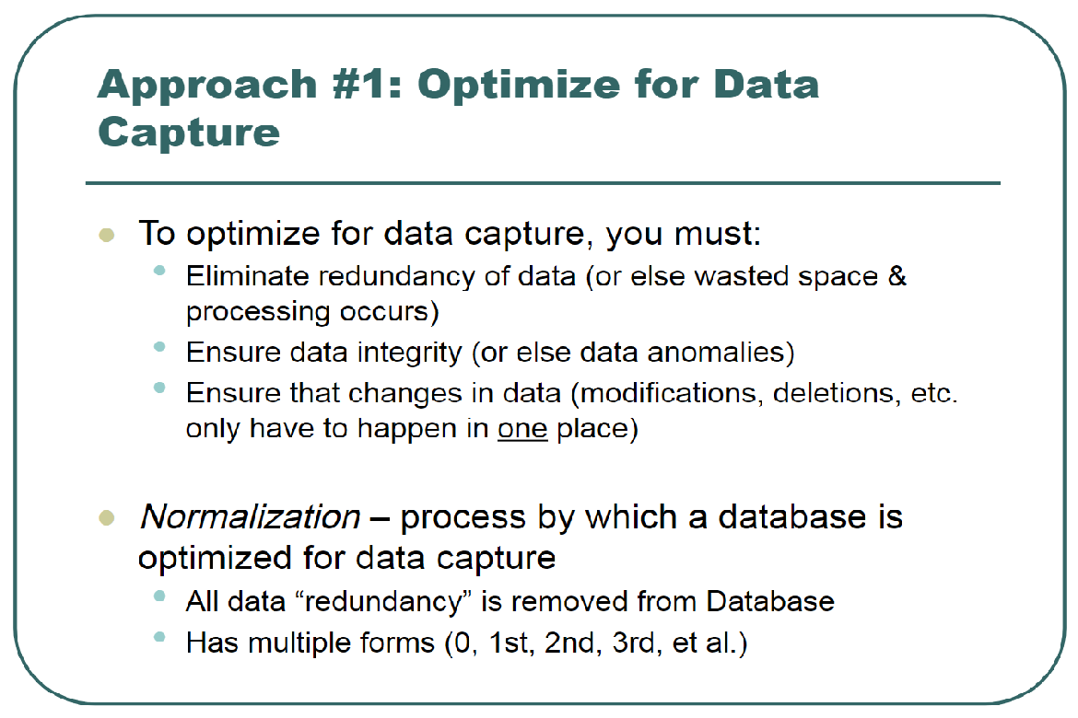
When Normalization is Required:

Slide 90
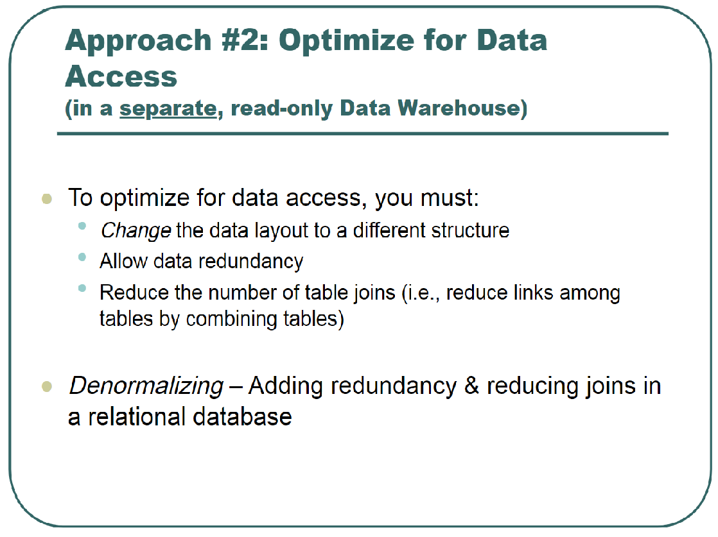
When Denormalization is Required:

Slide 91
CASSANDRA VS RDBMS
Cassandra has CQL as its primary way to access and alter the database.
CQL is an abstraction layer that makes you feel like you are working with RDBMS, but the underlying data model does not support all the features that a traditional database or SQL provides.
There is no group by, no relational integrity, foreign key constraints, and no join. There is some support for order, distinct, and triggers. There are things such as time to live (TTL) and write time functions

Slide 92
Inside the cell of Cassandra:
A cell is the smallest unit of the Cassandra data model. Cells are contained within a column family. A cell is essentially a key-value pair. The key of a cell is called cell name and value is called cell value.
A cell can be represented as a triplet of the cell name, value,and timestamp. The timestamp is used to resolve conflicts during read repair or to reconcile two writes that happen to the same cell at the same time; the one written later wins.
It’s worth noting that the timestamp is client-supplied data, and since it is critical to write a resolution, it is a good idea to have all your client application servers clock synchronized.

Slide 93
CQL
CQL – Stands for Cassandra Query Languagy

Slide 94
Cannot!!!
select count(*), city from people group by city

Slide 95
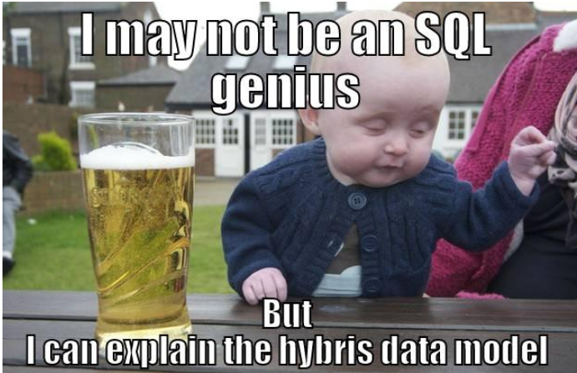

Slide 96
The counter column (cell)
A counter column is a special purpose cell to keep count. A client application can increment or decrement it by an integer value. Counter columns cannot be mixed with regular or any other cell types (as of Cassandra v2.0.9).
So, a counter column always lives in a table that has all the cells of type counter. Let’s call this type of table a counter table.
When we have to use a counter, we either plug it into an existing counter table or create a separate table with columns (CQL3 columns) as the counter type

Slide 97


Slide 98
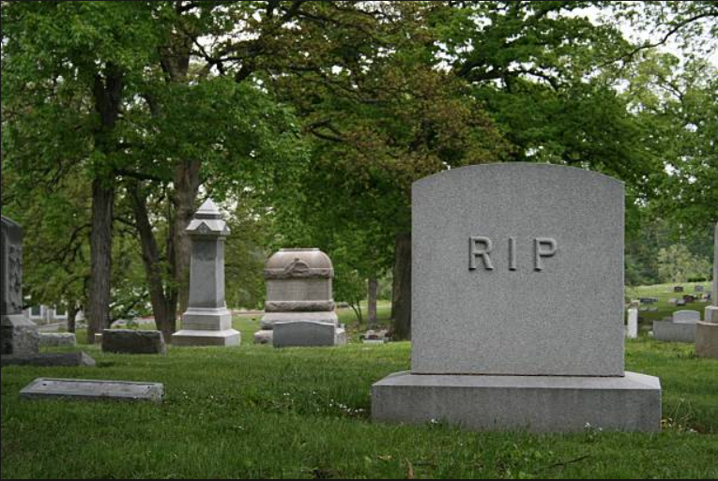

Slide 99
TOMBSTONE
In a distributed Database, replication is key for ensuring high availability and performance
Because Cassandra is a distributed system with immutable sstables, deletes are done differently compared to a relational database. Keep in mind that 1) writes can take time to reach all replicas (eventual consistency) and 2) cassandra has a sparse data model where a missing value for a column in a row in one sstable does not mean that the value is not present in another sstable

Slide 100
Deletes are accomplished by writing tombstones or 'null's to the database. Like other writes, tombstones have timestamps which allow us to determine if the tombstone is current or stale by following standard last write wins semantics
We also have the ability to establish data retention policies via TTL (Time to Live) expiration settings which can be configured at write time or at the table level. Once a cell's TTL expires it is treated as a tombstone for all intents and purposes

Slide 101
You may wonder, if deletes are just more writes, how do I ever reclaim disk after deleting data? Cassandra does eventually clean up tombstones, but will not do so until the data fits certain criteria, giving the system ample time to ensure the tombstone makes its way to all replicas before it is removed. Otherwise we may have scenarios where deleted values would again become readable again because a tombstone only made it to a limited set of replicas and then got cleaned up. The lifetime of a tombstone is defined by gc_grace_seconds. After gc grace, the tombstone becomes available for deletion during compaction.

Slide 102
The expiring cell
Every once in a while, you find yourself in a situation where the data gets stale after a given time, and you want to delete it because it does not have a future value or will possibly mess up with the result set. One such example could be a user session object or a password reset request that expires in a day, or maybe you are streaming out word frequency analysis on tweets posted in the last week (moving average).
Cassandra gives you the power to make any cell (and hence row) expire after a given time.
And if later,before the data is expired, you want to further change the expiry time, you can do that too.
This expiry time is commonly referred to as TTL

Slide 103

Monitoring

Slide 104
Monitoring is the key to provide reliable service. For distributed software, monitoring becomes more important and more complex.
Fortunately, Cassandra has an excellent tool built in for monitoring.
It is called nodetool. Apart from this, there are third-party tools to monitor Cassandra

Slide 105
The purpose of monitoring is to catch a problem about to occur or as soon as it happens and resolve it
It familiarizes you with the Java Management Extension (JMX) interface that Cassandra provides and then moves on to accessing it via JConsole

Slide 106
JMX
Cassandra has a powerful JMX interface to monitor almost all of its aspects
The way JMX technology manages and monitors a resource is called Managed Beans (MBeans).

Slide 107
JMX Mbeans – Different Packages
org.apache.cassandra.internal: This package includes MBeans that inform us about internal operations.
Therefore, you can view the status of AntiEntropy,FlushWriter, gossip, hinted handoff, response stage, migration and stream stages,pending range calculation, and commit log archival.
Other than getting internal status statistics, there is not much that can be done with these MBeans

Slide 108
org.apache.cassandra.db: This is probably the most interesting MBean package.
It includes vital metrics and actionable operational items. MBeans give statistics and commands for database components such as cache management, table, commit log, compaction control, hinted handoff management, storage service (general ring statistics and operations), and storage proxy (client read/write statistics).

Slide 109
org.apache.cassandra.net: This package contains statistics on network communication within the cluster.
It has some interesting Mbeans, such as FailureDetector, gossip, internode messaging, and data stream status

Slide 110
org.apache.cassandra.request: One can view pending and completed tasks at different stages.
The stages listed under this package are mutation, read repair, read,replicate on write, and read response

Slide 111
org.apache.cassandra.metrics: This package includes statistics about client read and write; specifically, the number of requests that are timed out and those that have thrown UnavailableException.
That is, not enough replicas are available to satisfy the operation with the given consistency level or, maybe, many replicas are down

Slide 112
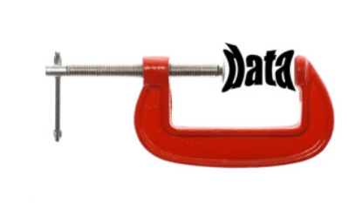
Compression

Slide 113
Enabling Compression
Table (or column family) compression is a very effective mechanism to improve read and write throughput.
As one can expect, compression (any) leads to compact representation of data at the cost of some CPU cycles. Enabling compression on a table makes the disk representation of the data (SSTables) terse. This means efficient disk utilization, lesser I/O, and a little extra burden to the CPU.
In the case of Cassandra, the trade-off between I/O and the CPU, due to compression, almost always yields favorable results. The cost of CPU performing compression and decompression is less than what it takes to read more data from the disk.

Slide 114
Types of Compressors
LZ4Compressor [Default]
Snappy
Deflate

Slide 115
For Example:
ALTER TABLE users WITH COMPRESSION = { 'sstable_compression': 'DeflateCompressor‘ };

Slide 116

Confused ☺

Slide 117
confusion matrix terminology :
A confusion matrix is a table that is often used to describe the performance of a classification model (or "classifier") on a set of test data for which the true values are known. The confusion matrix itself is relatively simple to understand, but the related terminology can be confusing

Slide 118
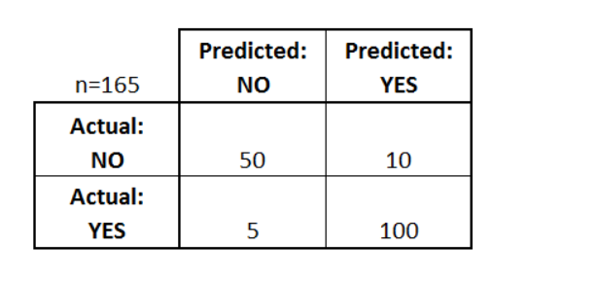
Confusion matrix for a binary classifier

Slide 119
Let's now define the most basic terms
true positives (TP): These are cases in which we predicted yes (they have the disease), and they do have the disease.
true negatives (TN): We predicted no, and they don't have the disease.
false positives (FP): We predicted yes, but they don't actually have the disease. (Also known as a "Type I error.")
false negatives (FN): We predicted no, but they actually do have the disease. (Also known as a "Type II error.")

Slide 120
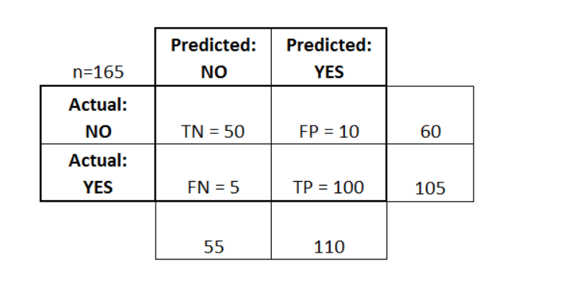
Added these terms to the confusion matrix

Slide 121
List of Rates for a confusion matrix
Accuracy: Overall, how often is the classifier correct?
(TP+TN)/total = (100+50)/165 = 0.91
Misclassification Rate: Overall, how often is it wrong?
(FP+FN)/total = (10+5)/165 = 0.09
equivalent to 1 minus Accuracy
also known as "Error Rate"
True Positive Rate: When it's actually yes, how often does it predict yes?
TP/actual yes = 100/105 = 0.95
also known as "Sensitivity" or "Recall"
False Positive Rate: When it's actually no, how often does it predict yes?
FP/actual no = 10/60 = 0.17
Specificity: When it's actually no, how often does it predict no?
TN/actual no = 50/60 = 0.83
equivalent to 1 minus False Positive Rate
Precision: When it predicts yes, how often is it correct?
TP/predicted yes = 100/110 = 0.91
Prevalence: How often does the yes condition actually occur in our sample?
actual yes/total = 105/165 = 0.64

Slide 122
Other scores to measure a classifier:
F1 – Score
ROC Curve

Slide 123
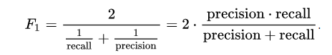
F1 - Score
This is the harmonic mean of precission and recall
Below is the formula of F1 Score:

Slide 124
ROC : Receiver Operating Characteristic
In statistics, a receiver operating characteristic curve, i.e. ROC curve, is a graphical plot that illustrates the diagnostic ability of a binary classifier system as its discrimination threshold is varied.
The ROC curve is created by plotting the true positive rate (TPR) against the false positive rate (FPR) at various threshold settings. The true-positive rate is also known as sensitivity, recall or probability of detection in machine learning. The false-positive rate is also known as the fall-out or probability of false alarm and can be calculated as (1 − specificity).

Slide 125
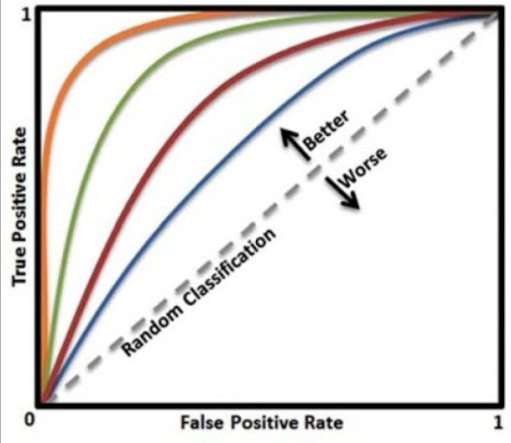
ROC CURVE

Slide 126
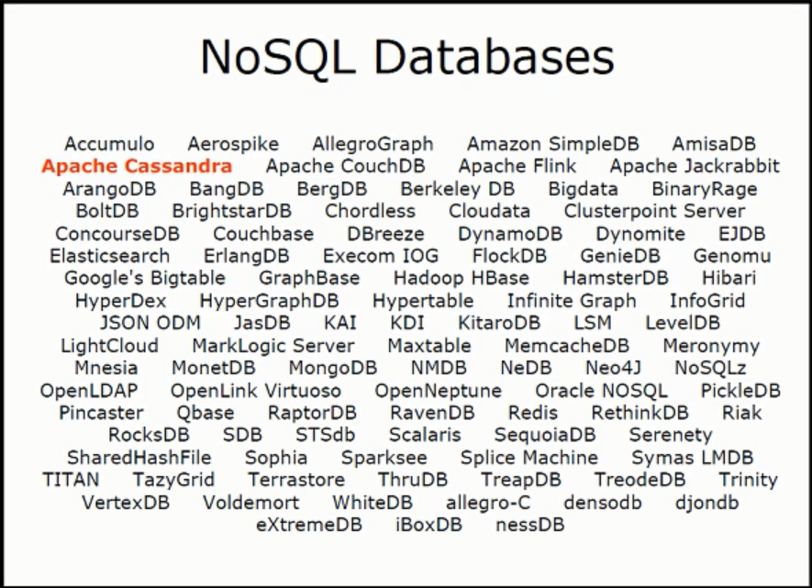

Slide 127
INSTALLATION
Conda install –c conda-forge Cassandra-driver

Slide 128
TOP THINGS TO REMEMBER
GOSSIP
PARTITIONERS
SNITCHES
SSTABLES
TOMBSTONES
COMPACTIONS

